Slide 1


2-HOUR BOOTCAMP
AI & Robotics Bootcamp
Python (NumPy · Pandas · Seaborn) → Machine Learning → Deep Learning
VSP TECHVERSE
An Institute of AI & Robotics
Notes:
Welcome to the AI and Robotics Bootcamp. In the next two hours we will go from Python basics to the data libraries NumPy, Pandas and Seaborn, then to machine learning, and finally deep learning. Everything is connected by one robot dataset, so you will see how the pieces fit together.

Slide 2









AGENDA
Our 2 Hours Together
0:00
Welcome & the robot story
5 min
0:05
Python essentials
10 min
0:15
NumPy: fast numbers
12 min
0:27
Pandas: tables of data
12 min
0:39
Seaborn: see the data
11 min
0:50
Break
5 min
0:55
Machine Learning
30 min
1:25
Deep Learning
25 min
1:50
Roadmap, projects & Q&A
10 min
Notes:
Here is our plan. Five minutes of welcome, then about 45 minutes of Python and its data libraries: NumPy, Pandas and Seaborn. A five-minute break, then 30 minutes of machine learning and 25 minutes of deep learning. We finish with a learning roadmap, project ideas and your questions.

Slide 3

OUR STORY
One Robot Problem, All Day Long
The problem: a factory runs 400 robots (arms, rovers and drones). Can we spot the robots that are about to fail, before they break down?
robot_health_data.csv · 400 rows
Column | Meaning
robot_type | arm / rover / drone
motor_temp_c | motor temperature (°C)
vibration_mm_s | vibration (mm/s)
current_a | motor current (A)
speed_rpm | motor speed (rpm)
hours_since_service | hours since last service
status | healthy / faulty ← answer
HOW EACH TOOL HELPS
NumPy: calculate with sensor readings
Pandas: load and explore the robot table
Seaborn: draw charts to spot patterns
Machine Learning: predict healthy or faulty
REAL USE Predictive maintenance: fix robots before they fail.
Deep Learning: neural networks for harder tasks like images
Notes:
To make today practical, we follow one story. A factory has 400 robots: arms, rovers and drones. Each one reports its motor temperature, vibration, current, speed and hours since its last service, and we know whether it was healthy or faulty. We will use NumPy, Pandas and Seaborn to understand the data, machine learning to predict faults, and deep learning to see how neural networks go further. This is called predictive maintenance, and it is a real use of AI in robotics.

Slide 4

01
10 min
Python Essentials
The language of AI & Robotics
Why Python?
Variables, lists, if/else, loops, functions
The Python AI toolkit
Notes:
Part one: Python essentials. We will see why Python is the main language for AI, recap the basics in one example, and meet the libraries we use today.

Slide 5





PYTHON
Why Python for AI & Robotics?
Easy to read
Huge toolkit
Used in robotics
Code looks close to plain English, so you focus on ideas, not syntax.
Ready-made libraries for maths, data, charts, ML, DL and computer vision.
Robot software, simulators and vision systems widely support Python.
Big community
Quick to try ideas
From idea to product
Free tutorials, examples and answers for almost every problem.
Write a few lines, run, see the result, improve.
The same language for experiments, data analysis and AI models.
Notes:
Why Python? It is easy to read, it has a huge collection of libraries for maths, data, charts, machine learning, deep learning and vision, and it is widely supported in robotics software. There is a large community, you can try ideas quickly, and you can use the same language from experiments to finished AI models.

Slide 6
PYTHON
Python Basics in One Example
basics.py
OUTPUT
# Variables and a list of sensor readings
robot = "Rover-1"
distances = [120, 85, 40, 15, 60] # cm
# A function with an if / else decision
def decide(distance):
if distance < 30:
return "STOP"
elif distance < 90:
return "SLOW"
else:
return "GO"
# A for loop over the readings
for d in distances:
print(robot, d, "cm ->", decide(d))
Rover-1 120 cm -> GO
Rover-1 85 cm -> SLOW
Rover-1 40 cm -> SLOW
Rover-1 15 cm -> STOP
Rover-1 60 cm -> SLOW
WHAT YOU SEE IN THE CODE
Variable: robot stores a name
List: distances holds 5 readings
Function: decide() is reusable logic
if / elif / else: choose STOP, SLOW or GO
for loop: repeat for every reading
Notes:
Here is all of basic Python in one robot example. A variable stores the robot name. A list stores five distance readings. A function called decide uses if, elif and else to choose STOP, SLOW or GO. A for loop runs the function on every reading. The output on the right shows the decision for each distance.

Slide 7

PYTHON
The Python AI Toolkit
data → understand → learn → see → act
NumPy
Pandas
Matplotlib & Seaborn
scikit-learn
TensorFlow / Keras
OpenCV
ROS
Fast maths on arrays
Tables: load, clean, explore
Charts and plots
Machine learning models
Deep learning (neural networks)
Computer vision: camera images
Robot Operating System
TODAY
TODAY
TODAY
TODAY
TODAY
NEXT STEP
NEXT STEP
PIPELINE A robot's AI pipeline: sensor data → NumPy/Pandas → charts → ML/DL model → decision → robot action.
Notes:
These are the main Python libraries for AI. Today we use NumPy for fast maths, Pandas for tables, Matplotlib and Seaborn for charts, scikit-learn for machine learning, and TensorFlow with Keras for deep learning. Your next steps after this bootcamp are OpenCV for camera images and ROS, the Robot Operating System, to connect AI to real robots.

Slide 8
02
12 min
NumPy
Fast maths on arrays of numbers
What is an array?
Maths on a whole array at once
Filtering with True / False masks
Notes:
Part two: NumPy, the library for fast numerical computing. Almost every AI library is built on top of NumPy arrays.

Slide 9
NUMPY
What is a NumPy Array?
An array is a grid of numbers of the same type. NumPy makes calculations on whole arrays fast, without writing loops.
1D ARRAY · shape (6,)
LIST vs ARRAY
58
74.8
61.2
82
66.5
70.3
 | Python list | NumPy array
temps * 2 | repeats the list | doubles every value
Speed | slow for big data | very fast
Types | can be mixed | all the same
Maths functions | few | mean, max, std, …
0
1
2
3
4
5
index →
2D ARRAY · shape (3, 2)
robot 1
58
2.1
robot 2
74.8
4.6
robot 3
61.2
3
ROBOTICS EXAMPLE A camera image is a NumPy array: height × width × 3 colour values for every pixel.
temp
vibration
Notes:
A NumPy array is a grid of numbers of the same type. A 1D array is like a row of six temperature readings, with positions called indexes starting at 0. A 2D array is like a table: here three robots and two sensors, shape 3 by 2. Unlike Python lists, arrays let you do maths on every value at once, and they are much faster. Even a camera image in robotics is just a NumPy array of pixel values.

Slide 10
NUMPY
NumPy in Action
numpy_demo.py
OUTPUT
import numpy as np
# motor temperature readings from 6 robots (°C)
temps = np.array([58.0, 74.8, 61.2, 82.0, 66.5, 70.3])
print("Shape :", temps.shape)
print("Mean :", temps.mean().round(1))
print("Max :", temps.max())
print("In °F :", temps * 9 / 5 + 32) # whole array at once
print("Hot? :", temps > 70) # True / False mask
print("Hot ones:", temps[temps > 70])
# 2D array: 3 robots x 2 sensors (temp, vibration)
data = np.array([[58.0, 2.1], [74.8, 4.6], [61.2, 3.0]])
print("Column means:", data.mean(axis=0).round(2))
Shape : (6,)
Mean : 68.8
Max : 82.0
In °F : [136.4 166.64 142.16 179.6 151.7 158.54]
Hot? : [False True False True False True]
Hot ones: [74.8 82. 70.3]
Column means: [64.67 3.23]
Vectorised: temps * 9/5 + 32 converts all 6 at once
Mask: temps > 70 gives True / False for each
Filter: temps[mask] keeps only hot motors
axis=0: mean of each column (sensor)
Notes:
Let us run NumPy. We create an array of six temperatures. shape tells us it has 6 values. mean and max summarise it. Multiplying the whole array converts every reading to Fahrenheit in one line, with no loop. temps greater than 70 gives a True or False mask, and using that mask inside square brackets keeps only the hot motors. With a 2D array, mean with axis equal to 0 gives the average of each column.

Slide 11
03
12 min
Pandas
Working with tables of data
DataFrame: rows and columns
Load a CSV, look, filter
Count and group
Notes:
Part three: Pandas. Real data comes in tables, like spreadsheets. Pandas lets us load, explore and clean them in Python.

Slide 12
PANDAS
The DataFrame: a Table in Python
index
columns (one per sensor)
MOST USED COMMANDS
 | robot_type | motor_temp_c | vibration_mm_s | status
0 | drone | 74.8 | 4.61 | faulty
1 | arm | 58.0 | 2.08 | healthy
2 | arm | 57.4 | 3.12 | healthy
3 | arm | 57.6 | 2.70 | healthy
… | … | … | … | …
pd.read_csv("file.csv")
load a CSV file
df.head()
first 5 rows
df.shape
(rows, columns)
df.describe()
quick statistics
df[df["col"] > 80]
filter rows
a column = a Series · df["motor_temp_c"]
df["col"].value_counts()
count each value
ROBOTICS EXAMPLE Every row is one robot, every column is one measurement. This is the shape ML models expect.
df.groupby("col").mean()
average per group
Notes:
Pandas gives us the DataFrame: a table with rows and columns, just like Excel. Each row is one robot, each column one measurement, and the index on the left numbers the rows. A single column is called a Series. On the right are the commands you will use most: read_csv to load, head and shape to look, describe for statistics, filtering with a condition, value_counts to count, and groupby to average by group.

Slide 13
PANDAS
Pandas in Action
pandas_demo.py
OUTPUT
import pandas as pd
df = pd.read_csv("robot_health_data.csv")
print(df.shape) # rows, columns
print(df[["robot_type", "motor_temp_c", "status"]].head(3))
# filter: robots hotter than 80 °C
hot = df[df["motor_temp_c"] > 80]
print("Hot robots:", len(hot))
# count each status
print(df["status"].value_counts())
# average temperature per robot type
print(df.groupby("robot_type")["motor_temp_c"].mean().round(1))
(400, 7)
robot_type motor_temp_c status
0 drone 74.8 faulty
1 arm 58.0 healthy
2 arm 57.4 healthy
Hot robots: 60
status
healthy 243
faulty 157
Name: count, dtype: int64
robot_type
arm 63.7
drone 60.8
rover 67.6
Name: motor_temp_c, dtype: float64
INSIGHT 60 robots run hotter than 80 °C, 157 of 400 are faulty, and rovers run hottest on average.
Notes:
Now Pandas on our real file. read_csv loads 400 rows and 7 columns. head shows the first rows of three columns. Filtering for temperature above 80 finds 60 hot robots. value_counts shows 243 healthy and 157 faulty robots. groupby by robot type shows rovers run hottest, around 67.6 degrees on average. In a few lines we already understand our data.

Slide 14
04
11 min
Seaborn
See patterns in the data
Histogram: how values spread
Scatter plot: relationships
Box plot: compare groups
Notes:
Part four: Seaborn, a library built on Matplotlib for beautiful statistical charts in one line of code. A good chart often tells you more than a table of numbers.

Slide 15
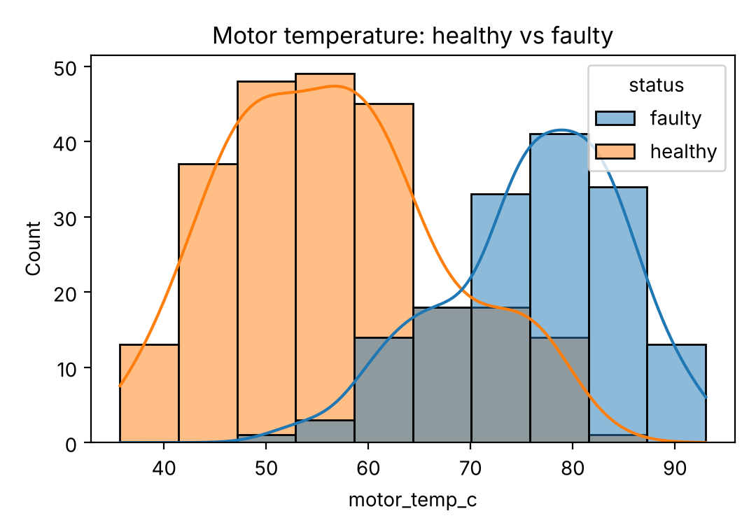
SEABORN
Histogram: How Is Temperature Spread?
histogram.py
import pandas as pd
import seaborn as sns
import matplotlib.pyplot as plt
df = pd.read_csv("robot_health_data.csv")
sns.histplot(data=df, x="motor_temp_c", hue="status", kde=True)
plt.title("Motor temperature: healthy vs faulty")
plt.show()
WHAT WE SEE Faulty robots (blue) mostly run above 70 °C, healthy ones (orange) around 45-60 °C. Temperature will be a strong clue for our ML model.
DATA Every chart here uses the same robot_health_data.csv file.
Notes:
A histogram counts how many values fall in each range. With hue equal to status, healthy and faulty robots get different colours, and kde adds a smooth curve. Faulty robots clearly run hotter, so temperature should help predict faults.

Slide 16
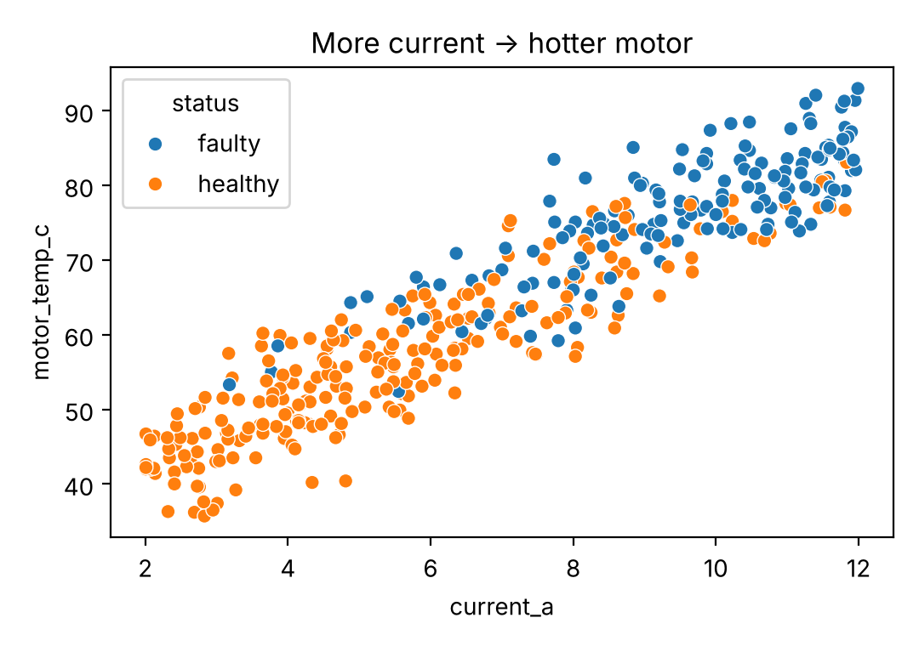
SEABORN
Scatter Plot: Current vs Temperature
scatter.py
import pandas as pd
import seaborn as sns
import matplotlib.pyplot as plt
df = pd.read_csv("robot_health_data.csv")
sns.scatterplot(data=df, x="current_a", y="motor_temp_c",
hue="status")
plt.title("More current -> hotter motor")
plt.show()
WHAT WE SEE More current means a hotter motor: an almost straight-line relationship. We will predict temperature from current with linear regression later.
DATA Every chart here uses the same robot_health_data.csv file.
Notes:
A scatter plot shows the relationship between two numbers. Each dot is a robot. As current goes up, motor temperature goes up in an almost straight line, and faulty robots sit higher up. We will use this relationship for linear regression in the machine learning part.

Slide 17
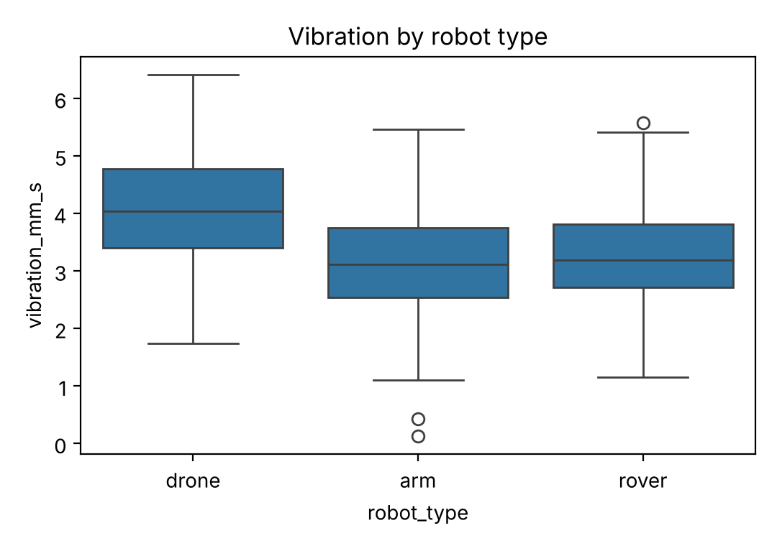
SEABORN
Box Plot: Vibration by Robot Type
boxplot.py
import pandas as pd
import seaborn as sns
import matplotlib.pyplot as plt
df = pd.read_csv("robot_health_data.csv")
sns.boxplot(data=df, x="robot_type", y="vibration_mm_s")
plt.title("Vibration by robot type")
plt.show()
WHAT WE SEE Drones vibrate the most. The box shows the middle 50% of robots, the line is the median, and the circles are unusual values (outliers).
DATA Every chart here uses the same robot_health_data.csv file.
Notes:
A box plot compares groups. The box holds the middle half of the values, the line inside is the median, the whiskers show the range and the circles are outliers. Drones clearly vibrate more than arms and rovers.

Slide 18
5-Minute Break
Stretch, grab water, and think: what could a robot learn from data?
Next: Machine Learning · Deep Learning
Notes:
Let us take a five-minute break. When we come back we move from understanding data to learning from it with machine learning and deep learning.

Slide 19
05
30 min
Machine Learning
Teaching computers to learn from data
What ML is and its 3 types
Regression, classification, clustering
Live demos on robot data
Notes:
Part five: machine learning. This is where the computer starts learning rules from data by itself.

Slide 20
MACHINE LEARNING
What is Machine Learning?
Machine Learning is a branch of AI where a computer learns patterns from examples (data) instead of being given every rule by a programmer.
TRADITIONAL PROGRAMMING
Data
+
Rules
Answers
MACHINE LEARNING
Data
+
Answers
Rules (a model)
Learns from past examples
Finds the link between inputs and outputs
Predicts answers for new data
Gets better with more good data
Then the model gives answers for new data it has never seen.
ROBOTICS EXAMPLE Instead of writing "if temp > 75 and vibration > 4 then faulty", we show the model 400 labelled robots and it works out the rule itself.
Notes:
In traditional programming we give the computer data and rules, and it gives answers. In machine learning we give it data and the correct answers, and it learns the rules itself: that learned rule is called a model. Then the model can answer for new data. For our robots, instead of writing the fault rule by hand, we show the model 400 labelled robots.

Slide 21


MACHINE LEARNING
3 Types of Machine Learning
Supervised Learning
Unsupervised Learning
Reinforcement Learning
Learns from labelled examples (data + correct answers).
Finds hidden groups or patterns in data with no answers.
Learns by trial and error, getting rewards for good actions.
Regression: predict a number
Classification: predict a category
Clustering: group similar items
Anomaly detection: spot the odd one
Agent, actions, reward
Improves over many attempts
ROBOT EXAMPLE
Predict healthy / faulty from sensors
ROBOT EXAMPLE
Group robots with similar behaviour
ROBOT EXAMPLE
A robot learning to walk or grasp
Notes:
There are three types of machine learning. Supervised learning learns from labelled examples: regression predicts numbers, classification predicts categories, like healthy or faulty. Unsupervised learning has no answers; it finds groups and unusual items by itself. Reinforcement learning learns by trial and error with rewards, like a robot learning to walk.

Slide 22
MACHINE LEARNING
Machine Learning Models at a Glance
Machine Learning
Supervised Learning
Unsupervised Learning
Reinforcement Learning
Regression
Classification
Clustering
Dimensionality Reduction
Association
Value-Based
Policy-Based
Linear
Logistic Regression
K-Means
PCA
Apriori
Q-Learning
Policy Gradient
Polynomial
Decision Tree
Hierarchical
t-SNE
FP-Growth
SARSA
Actor-Critic
Ridge & Lasso
Random Forest
DBSCAN
Decision Tree
SVM
Random Forest
KNN
SVR
Naive Bayes
KNN
Notes:
Here is a map of the most common machine learning models, grouped by type. Supervised learning splits into regression and classification models. Unsupervised learning covers clustering, dimensionality reduction and association rules. Reinforcement learning has value-based and policy-based methods.

Slide 23


MACHINE LEARNING
The ML Workflow
Collect data
Prepare
Split
Train
Evaluate
Deploy
sensor logs, CSV
clean, choose X and y
80% train, 20% test
model.fit()
accuracy, R²
use it on the robot
Why split the data?
Like a student and an exam: the model studies the training data, then we test it on questions it has never seen. That shows how it will do in the real world.
Same 4 lines for almost every model
model = SomeModel()
model.fit(X_train, y_train)
y_pred = model.predict(X_test)
score(y_test, y_pred)
Notes:
Every ML project follows the same workflow: collect data, prepare it and choose inputs X and answer y, split it into training and test sets, train the model, evaluate it, and finally deploy it on the robot. We split so we can test the model on data it has never seen, like an exam. And in scikit-learn almost every model uses the same four lines: create, fit, predict and score.

Slide 24
MACHINE LEARNING
Regression vs Classification
Regression
Classification
Predicts a NUMBER
Predicts a CATEGORY
ROBOT EXAMPLES
ROBOT EXAMPLES
Motor temperature: 77.2 °C
Battery time left: 42 minutes
Distance to obstacle: 1.8 m
Robot status: healthy / faulty
Terrain: smooth / rough
Object: bolt / nut / washer
POPULAR MODELS
POPULAR MODELS
Linear Regression · Decision Tree · Random Forest
Logistic Regression · KNN · SVM · Random Forest
HOW WE MEASURE IT
HOW WE MEASURE IT
MAE, R² score
Accuracy, confusion matrix
Notes:
Supervised learning has two kinds of problems. Regression predicts a number, like motor temperature or battery time. Classification predicts a category, like healthy or faulty. Different models suit each, and we measure them differently: regression with error and R squared, classification with accuracy and the confusion matrix. Let us try one of each on our robot data.

Slide 25
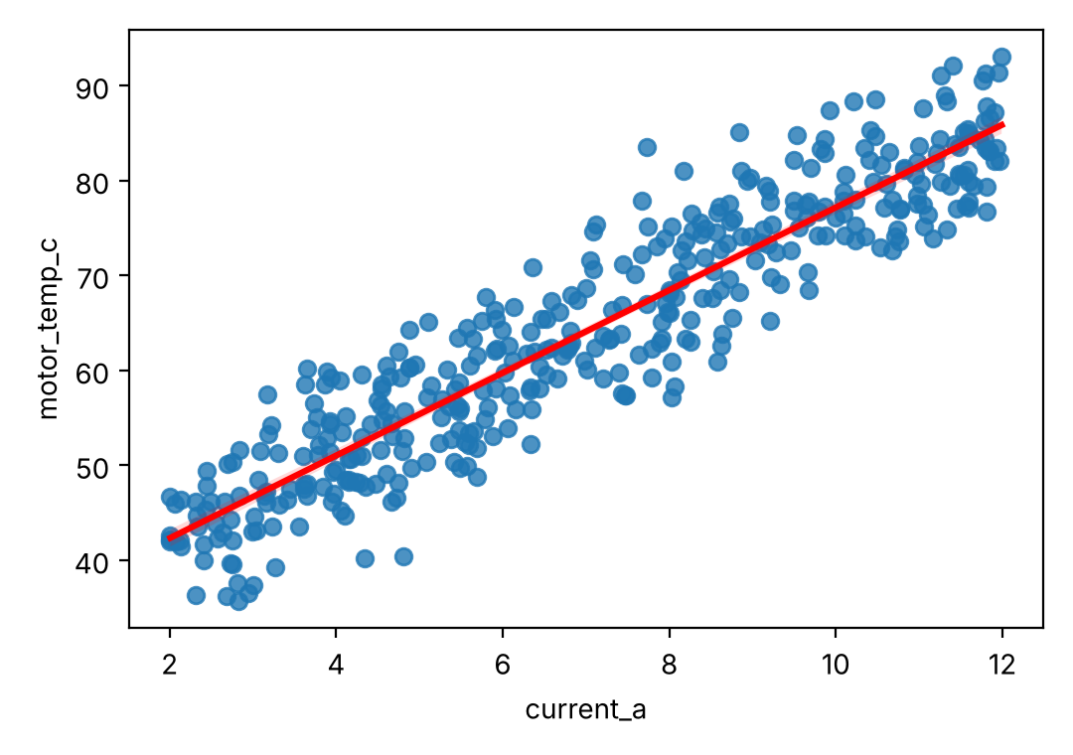
ML DEMO 1 · REGRESSION
Predict Motor Temperature from Current
regression.py
import pandas as pd
import seaborn as sns
import matplotlib.pyplot as plt
from sklearn.model_selection import train_test_split
from sklearn.linear_model import LinearRegression
from sklearn import metrics
df = pd.read_csv("robot_health_data.csv")
X, y = df[["current_a"]], df["motor_temp_c"]
X_train, X_test, y_train, y_test = train_test_split(
X, y, test_size=0.2, random_state=42)
model = LinearRegression().fit(X_train, y_train)
print("Slope :", model.coef_[0].round(2), "°C per amp")
print("Intercept:", model.intercept_.round(1))
y_pred = model.predict(X_test)
print("R2 score :", round(metrics.r2_score(y_test, y_pred), 2))
print("Predict 10 A:", model.predict(
pd.DataFrame({"current_a": [10]}))[0].round(1), "°C")
sns.regplot(data=df, x="current_a", y="motor_temp_c",
line_kws={"color": "red"})
plt.show()
OUTPUT
Slope : 4.37 °C per amp
Intercept: 33.5
R2 score : 0.84
Predict 10 A: 77.2 °C
Each extra amp adds about 4.4 °C. R² = 0.84: current explains 84% of the change in temperature.
Notes:
Linear regression fits the best straight line through the data. We predict motor temperature from current. The slope says each amp adds about 4.37 degrees. R squared of 0.84 on the test data means the line explains 84 percent of the variation. We can then predict new values: at 10 amps, about 77 degrees.

Slide 26
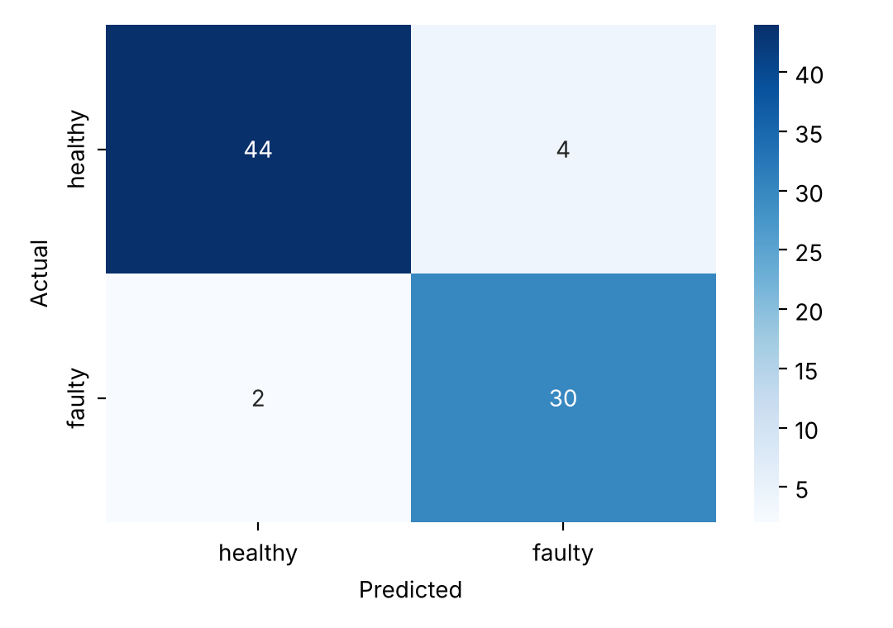
ML DEMO 2 · CLASSIFICATION
Predict Healthy or Faulty
classification.py
CONFUSION MATRIX (TEST DATA)
import pandas as pd
import seaborn as sns
import matplotlib.pyplot as plt
from sklearn.model_selection import train_test_split
from sklearn.ensemble import RandomForestClassifier
from sklearn import metrics
# 1. Load data, choose inputs (X) and answer (y)
df = pd.read_csv("robot_health_data.csv")
X = df[["motor_temp_c", "vibration_mm_s", "current_a",
"speed_rpm", "hours_since_service"]]
y = df["status"]
# 2. Split: 80% to learn, 20% to test
X_train, X_test, y_train, y_test = train_test_split(
X, y, test_size=0.2, random_state=42)
# 3. Train the model
model = RandomForestClassifier(n_estimators=100, random_state=42)
model.fit(X_train, y_train)
# 4. Predict and evaluate
y_pred = model.predict(X_test)
print("Accuracy:", round(metrics.accuracy_score(y_test, y_pred), 2))
labels = ["healthy", "faulty"]
cm = metrics.confusion_matrix(y_test, y_pred, labels=labels)
sns.heatmap(cm, annot=True, cmap="Blues",
xticklabels=labels, yticklabels=labels)
plt.xlabel("Predicted"); plt.ylabel("Actual")
plt.show()
OUTPUT
Accuracy: 0.93
93% of test robots classified correctly. Only 2 faulty robots were missed: those are the costly mistakes.
Notes:
Now classification. We use five sensor columns as inputs and status as the answer, split 80/20, and train a random forest, which is a team of 100 decision trees that vote. On the 80 test robots it is 93 percent accurate. In the confusion matrix, 44 healthy and 30 faulty robots are correct; 4 healthy robots were flagged faulty and only 2 faulty robots were missed.

Slide 27
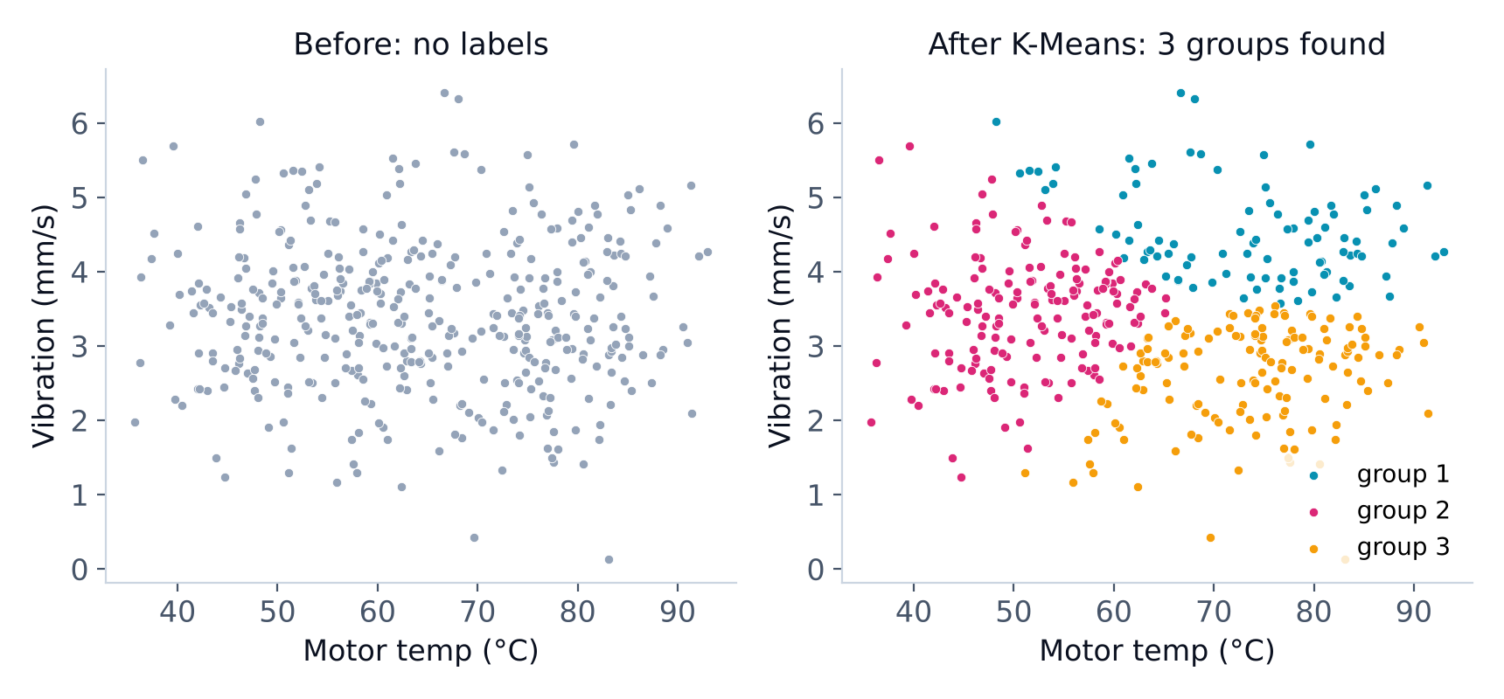
MACHINE LEARNING
Unsupervised: Finding Groups with K-Means
No answers given. K-Means puts robots into k groups so that robots in the same group have similar sensor readings.
1
Choose k (number of groups)
2
Place k centres at random
3
Each robot joins its nearest centre
4
Move centres to the middle; repeat
ROBOTICS EXAMPLE Group robots by behaviour (cool & calm, hot, shaky) to plan maintenance, even without fault labels.
Notes:
In unsupervised learning we have no answers. K-Means clustering groups similar items. We choose the number of groups, k equals 3 here. The algorithm places three centres, assigns each robot to the nearest one, moves the centres to the middle of their groups and repeats. On the left are the robots with no labels; on the right K-Means found three groups by temperature and vibration.

Slide 28
MACHINE LEARNING
How Good Is My Model?
CLASSIFICATION
REGRESSION
Accuracy share of correct predictions
MAE average size of the error
Confusion matrix table of right and wrong answers
R² score 1.0 = perfect, 0 = no better than the average
Precision / Recall how many alarms were real / how many faults we caught
RMSE like MAE but punishes big errors more
Watch out: overfitting
A model that memorises the training data scores very high in training but poorly on new data, like a student who memorises answers. Always judge a model on the test data.
Notes:
How do we judge a model? For classification: accuracy, the confusion matrix, and precision and recall, which tell us how many alarms were real and how many faults we caught. For regression: MAE, the average error, R squared, and RMSE. And always watch for overfitting: a model that memorises the training data but fails on new data. That is why we test on unseen data.

Slide 29
06
25 min
Deep Learning
Neural networks: learning like a brain
AI vs ML vs DL
Neurons, layers and training
CNNs and a live Keras demo
Notes:
Part six: deep learning. These are the neural networks behind self-driving cars, face recognition, voice assistants and modern robots.

Slide 30
DEEP LEARNING
AI vs Machine Learning vs Deep Learning
Artificial Intelligence
Any technique that makes machines act smart, including hand-written rules.
Artificial Intelligence
Machine Learning
Machine Learning
AI that learns patterns from data (today: linear regression, random forest, K-Means).
Deep
Learning
Deep Learning
ML using neural networks with many layers. Best for images, sound and language.
ROBOTICS EXAMPLE Deep learning lets robots see, hear and understand language.
Notes:
Think of three circles. Artificial intelligence is the biggest idea: any way of making machines act smart. Machine learning is part of AI, where machines learn from data. Deep learning is part of machine learning, using neural networks with many layers. Deep learning is what lets robots see with cameras, hear speech and understand language.

Slide 31
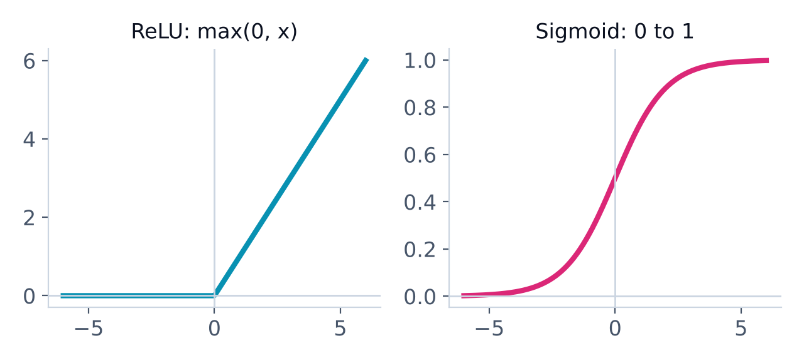
DEEP LEARNING
The Artificial Neuron
A neuron takes inputs, multiplies each by a weight (how important it is), adds them up with a bias, and passes the result through an activation function.
temp
w₁
Σ
+ bias
activation
output
w₂
ReLU keeps positives, turns negatives to 0 (hidden layers). Sigmoid / softmax turn numbers into probabilities (output layer).
vibration
w₃
current
output = activation(w₁x₁ + w₂x₂ + w₃x₃ + b)
Notes:
A neural network is made of artificial neurons. Each neuron takes inputs, multiplies each by a weight that says how important it is, adds them together with a bias, and passes the total through an activation function. ReLU, used in hidden layers, keeps positive values and turns negatives into zero. Sigmoid and softmax, used at the output, turn numbers into probabilities. Learning means finding good weights.

Slide 32
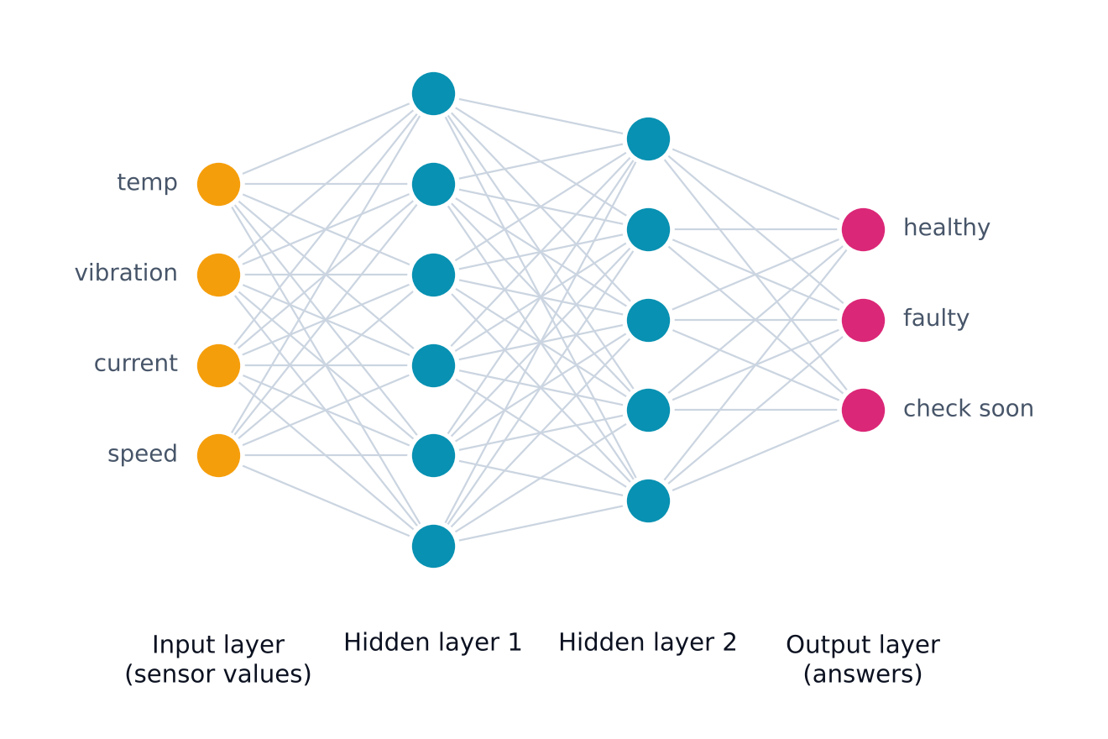
DEEP LEARNING
A Neural Network: Layers of Neurons
Input layer
One neuron per input value (sensor readings or image pixels).
Hidden layers
Find patterns step by step. "Deep" = many hidden layers.
Output layer
One neuron per possible answer, with a probability for each.
NOTE Every line is a weight the network learns.
Notes:
Neurons are arranged in layers. The input layer has one neuron per input, like each sensor value or each pixel. Hidden layers find patterns, from simple to complex; deep learning simply means many hidden layers. The output layer has one neuron per possible answer and gives a probability for each. Every line in this picture is a weight that the network learns during training.

Slide 33
DEEP LEARNING
How Does a Network Learn?
1. Forward pass
KEY WORDS
Epoch
one full pass over all training data
Data flows through the layers and the network makes a guess
4. Update
2. Loss
Batch
a small group of rows processed together
repeat
Nudge every weight to reduce the error (optimizer, e.g. Adam)
Measure how wrong the guess was (the error)
Learning rate
how big each weight nudge is
3. Backpropagation
Loss
the error the network tries to shrink
Work out how much each weight caused the error
ANALOGY Like learning to throw: throw, see the miss, adjust, throw again.
Notes:
How does a network learn? First the forward pass: data goes through the layers and the network guesses. Then we measure the loss, how wrong it was. Backpropagation works out how much each weight caused the error, and the optimizer nudges every weight to reduce it. This loop repeats thousands of times. One pass over all the training data is called an epoch. It is like learning to throw a ball: throw, see how far you missed, adjust and try again.

Slide 34



DEEP LEARNING
Types of Deep Learning Networks
CNN
RNN / LSTM
Transformers
Deep RL
Convolutional Neural Network
Recurrent networks
Attention-based models
Deep reinforcement learning
BEST FOR
BEST FOR
BEST FOR
BEST FOR
Images and video
Sequences and time series
Language, and now vision too
Decisions by trial and error
IN ROBOTICS
IN ROBOTICS
IN ROBOTICS
IN ROBOTICS
Detect obstacles, read signs, inspect parts
Predict sensor values over time, motion paths
Voice commands, chat assistants, robot planning
Walking, balancing, grasping objects
Notes:
There are a few main families of deep learning networks. CNNs, convolutional neural networks, are best for images and video: detecting obstacles or inspecting parts. RNNs and LSTMs handle sequences over time, like sensor streams. Transformers power language models and chat assistants and are now used for vision and robot planning too. Deep reinforcement learning teaches robots skills like walking and grasping by trial and error.

Slide 35
DEEP LEARNING
Deep Learning Models at a Glance
Deep Learning
Feedforward (ANN)
CNN
RNN
Transformers
Generative Models
Deep Reinforcement Learning
Perceptron
LeNet
Simple RNN
BERT
Autoencoder
DQN
Multilayer Perceptron (MLP)
AlexNet
LSTM
GPT-style LLMs
VAE
PPO
VGG
GRU
Vision Transformer (ViT)
GAN
DDPG
ResNet
Vision-Language-Action (VLA)
Diffusion Models
SAC
YOLO
U-Net
Notes:
And here is a map of the main deep learning model families: feedforward networks, convolutional networks for images, recurrent networks for sequences, transformers for language and vision, generative models that create new data, and deep reinforcement learning for robot control.

Slide 36
DEEP LEARNING
How a CNN Sees an Image
Camera image
Convolution
Pooling
More layers
Dense + output
pixels as numbers
small filters find edges, corners, shapes
shrink the image, keep the strongest features
combine shapes into parts and objects
"obstacle: 96%"
KEY IDEA Early layers see edges; deeper layers see wheels, people and boxes. Nobody programs these filters: the CNN learns them.
Notes:
A CNN looks at an image in stages. The image is just numbers for each pixel. Convolution layers slide small filters over the image to find edges and corners. Pooling layers shrink the image but keep the strongest features. Deeper layers combine these into parts and whole objects, and the final dense layer outputs a probability, like obstacle 96 percent. The network learns the filters itself from labelled images.

Slide 37
DL DEMO · KERAS
Build a Neural Network in Keras
neural_net.py
OUTPUT
from sklearn.datasets import load_digits
from sklearn.model_selection import train_test_split
from tensorflow import keras
keras.utils.set_random_seed(42)
digits = load_digits() # 1,797 images, 8 x 8 pixels
X = digits.data / 16.0 # scale pixels to 0-1
y = digits.target # labels 0-9
X_train, X_test, y_train, y_test = train_test_split(
X, y, test_size=0.2, random_state=42)
model = keras.Sequential([
keras.Input(shape=(64,)), # 64 pixels in
keras.layers.Dense(64, activation="relu"), # hidden layer 1
keras.layers.Dense(32, activation="relu"), # hidden layer 2
keras.layers.Dense(10, activation="softmax")]) # 10 digits out
model.compile(optimizer="adam",
loss="sparse_categorical_crossentropy",
metrics=["accuracy"])
history = model.fit(X_train, y_train, epochs=20, verbose=0)
loss, acc = model.evaluate(X_test, y_test, verbose=0)
print("Parameters :", model.count_params())
print("Test accuracy:", round(acc, 3))
Parameters : 6570
Test accuracy: 0.967
WHAT THE CODE DOES
Data: 1,797 hand-written digits, 8×8 pixels
Sequential: layers stacked in order
Dense(64), Dense(32): hidden layers with ReLU
Dense(10, softmax): one probability per digit
fit(epochs=20): 20 passes over the data
Notes:
Now a real neural network in Keras, part of TensorFlow. We use a small dataset of 1,797 hand-written digits, each an 8 by 8 pixel image, so 64 inputs. We stack layers with Sequential: two hidden Dense layers with ReLU, and an output layer of 10 neurons with softmax, one for each digit. We compile with the Adam optimizer and train for 20 epochs. The network has 6,570 weights and gets 96.7 percent of the test images right.

Slide 38
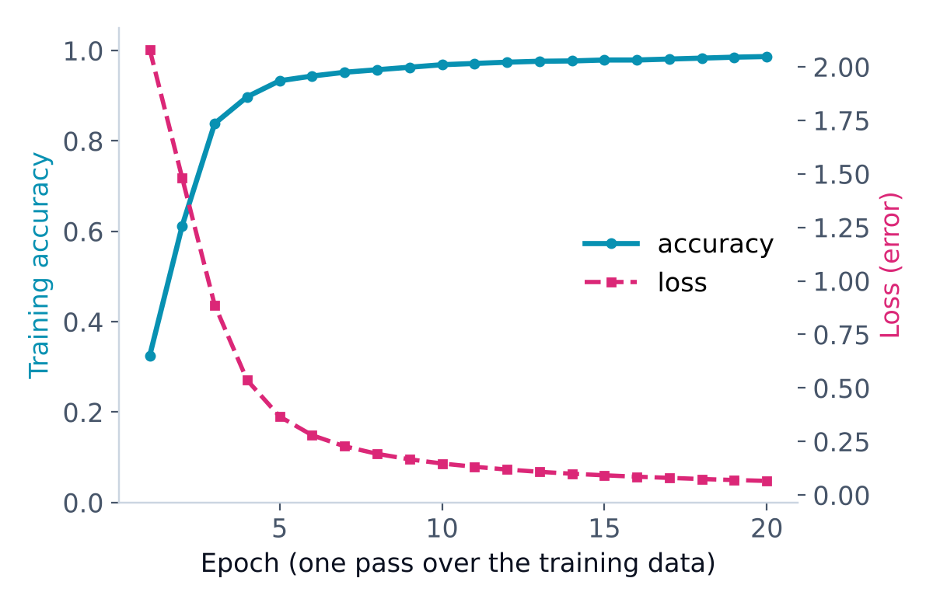
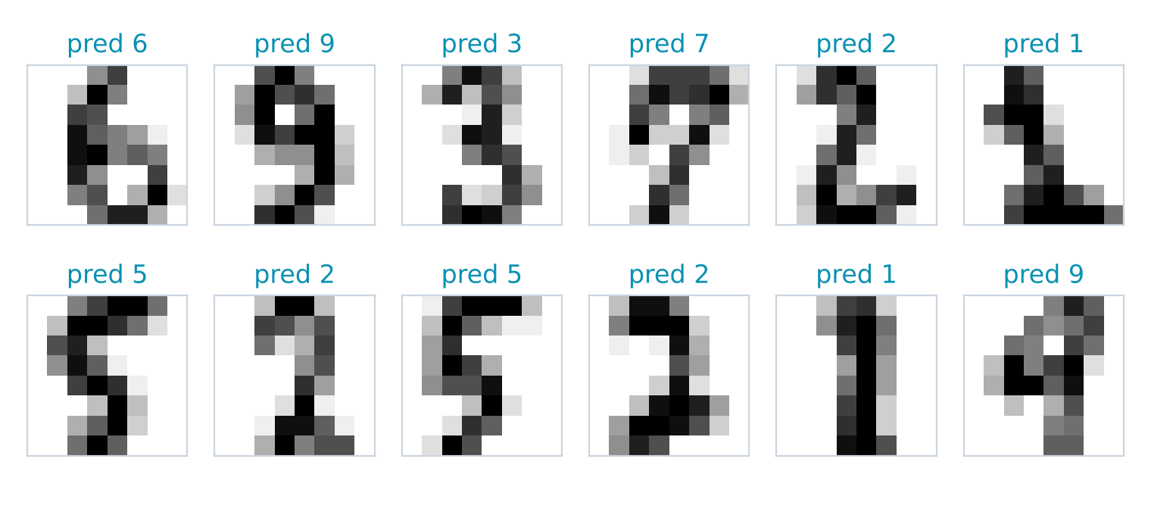
DL DEMO · KERAS
Watching the Network Learn
12 test images the network has never seen: all 12 predicted correctly.
From digits to robots
Swap the digits for camera images of parts, roads or faces, and use a CNN: the same Keras steps let a robot see.
Accuracy rises and loss falls with every epoch.
Notes:
Here is the network learning. In the first epoch accuracy is only about 30 percent; by epoch 5 it passes 90 percent, and the loss, the error, keeps falling. On the right are 12 test images the network never saw during training: it predicts all of them correctly. The same process, with a CNN and camera images, is how robots learn to recognise parts, roads and people.

Slide 39





DEEP LEARNING
Deep Learning in Robotics Today
Self-driving vehicles
Robot grasping
Quality inspection
Detect lanes, cars and people from cameras and LiDAR
Pick up objects of any shape in warehouses
Spot scratches and defects on production lines
Voice control
Drones
Predictive maintenance
Understand spoken commands
Navigate, avoid obstacles and track targets
Predict failures from vibration and sound
Notes:
Deep learning is already everywhere in robotics: self-driving vehicles detecting lanes and people, warehouse robots grasping objects, cameras inspecting products for defects, voice-controlled machines, drones that navigate on their own, and predictive maintenance from vibration and sound, just like our robot story.

Slide 40







DEEP LEARNING
How AI Runs Inside a Humanoid Robot
INSIDE THE HUMANOID ROBOT
SENSORS → high-level
High-Level Compute
onboard AI computer (GPU) · "the brain"
Cameras / depth camera eyes
Microphones ears
Development Computer
powerful GPU · in the lab
LLM
understand speech & plan tasks
Vision CNN
see objects & people
Navigation
map & path planning
LiDAR distance to everything
IMU tilt & balance
Collect large datasets
Train deep learning models (LLM, vision CNN)
Test in simulation
Write and debug code
Force / touch sensors hands & feet
built with deep learning
commands ↓ target joint angles, "walk", "grasp"
feedback ↑ joint angles, balance, status
MOTORS ← low-level
Low-Level Compute
real-time microcontrollers · "the spinal cord"
Neck motors turn the head
Shoulder & elbow motors move the arms
DEPLOY →
copy the trained model onto the robot
Motor control
PID loop, ~1000×/s
Balance
keep the robot upright
Safety
emergency stop, limits
Hand / gripper motors grasp objects
Hip & knee motors walk
Ankle motors balance on uneven ground
Notes:
This is how AI actually runs on a humanoid robot. On the left is the development computer in the lab, with a powerful GPU. There we collect data, train deep learning models such as large language models and vision networks, and test them in simulation. The trained models are then deployed onto the robot. Inside the robot, the high-level compute is the brain: an onboard AI computer that runs the LLM to understand speech and plan tasks, vision networks to see objects and people, and navigation. It receives data from all the sensors: cameras, microphones, LiDAR, the IMU for balance, and touch sensors. It sends commands like walk forward or grasp the cup, as target joint angles, down to the low-level compute. The low-level compute is like the spinal cord: real-time microcontrollers that run the motor control loops about a thousand times per second, keep the robot balanced and handle safety stops. They drive the motors in the neck, arms, hands, hips, knees and ankles, and send joint feedback back up to the brain. Deep learning thinks slowly but smartly at the top; fast, simple control loops act at the bottom.

Slide 41
DEEP LEARNING
Machine Learning or Deep Learning?
 | Machine Learning | Deep Learning
Best data | Tables: rows and columns | Images, audio, text, video
Data needed | Hundreds to thousands of rows | Thousands to millions of examples
Features | We choose them (temp, vibration…) | Learns them by itself
Hardware | A normal laptop | Often needs a GPU
Training time | Seconds to minutes | Minutes to days
Explainable? | Usually easier | Harder ("black box")
Today's example | Robot fault prediction: 93% | Digit recognition: 96.7%
Rule of thumb: tables → start with ML. Images, sound or text → deep learning.
Notes:
So when do we use which? Machine learning is best for tables with hundreds or thousands of rows, runs on a laptop, trains in seconds and is easier to explain. Deep learning shines on images, sound and text, learns its own features, but needs more data, more computing power and more time. Rule of thumb: tables, start with machine learning; images, sound or text, use deep learning.

Slide 42
07
10 min
Wrap-Up
Where to go from here
What we covered today
Your learning roadmap
Project ideas and Q&A
Notes:
Final part: let us recap, see a roadmap for what to learn next, and look at some project ideas.

Slide 43
RECAP
What We Learned Today
Python
variables, lists, functions, loops
NumPy
fast maths on arrays, masks
Pandas
load, filter, count, group tables
Seaborn
histogram, scatter, box plot
Machine Learning
regression R² 0.84, classification 93%, K-Means
Deep Learning
neurons, layers, CNNs, Keras 96.7%
Notes:
In two hours we covered a lot. Python basics. NumPy for fast maths. Pandas for tables. Seaborn for charts. Machine learning: regression with R squared 0.84, classification at 93 percent accuracy and K-Means clustering. And deep learning: neurons, layers, CNNs and a Keras network at 96.7 percent.

Slide 44
NEXT STEPS
Your Learning Roadmap
✓ Steps 1-5 started today
7
6
Robotics
ROS, sensors, projects
5
Computer Vision
OpenCV + CNNs
4
Deep Learning
TensorFlow / Keras
3
Machine Learning
scikit-learn
2
Matplotlib & Seaborn
visualisation
1
NumPy & Pandas
data handling
Python
core language
Climb one step at a time and build a small project at each step.
Notes:
Here is your roadmap. Python first, then NumPy and Pandas, then visualisation, machine learning with scikit-learn, deep learning with TensorFlow and Keras, computer vision with OpenCV, and finally robotics with ROS and real sensors. Today you took your first steps on the first five. Climb one step at a time and build a small project at every step.

Slide 45
NEXT STEPS
Mini Project Ideas to Try
Beginner
Beginner
Intermediate
Robot health dashboard
Battery life predictor
Obstacle decision model
Use Pandas + Seaborn on robot_health_data.csv to find which robots need service.
Predict battery runtime from payload and speed with linear regression.
Train a decision tree to choose GO / TURN / STOP from distance sensors.
Intermediate
Advanced
Advanced
Digit / object recogniser
Line-following robot + ML
Gesture-controlled robot
Extend today's Keras demo, then try a CNN on small images.
Log sensor data from a real or simulated robot and train a model on it.
Use a camera and a deep learning model to recognise hand gestures.
Notes:
Here are six project ideas from beginner to advanced. Start with a robot health dashboard or a battery life predictor, move on to an obstacle decision model or an object recogniser, and when you are ready, collect data from a real or simulated robot, or build a gesture-controlled robot with a camera and deep learning.

Slide 46
Questions?
Ask anything about Python, Machine Learning, Deep Learning or Robotics
Notes:
Now it is your turn. Ask me anything about Python, machine learning, deep learning or robotics.

Slide 47
Thank You
Keep learning, keep building
VSP TECHVERSE
An Institute of AI & Robotics
Notes:
Thank you for joining the AI and Robotics bootcamp. Keep learning, keep building, and we hope to see you in our full courses.

